Slide 1
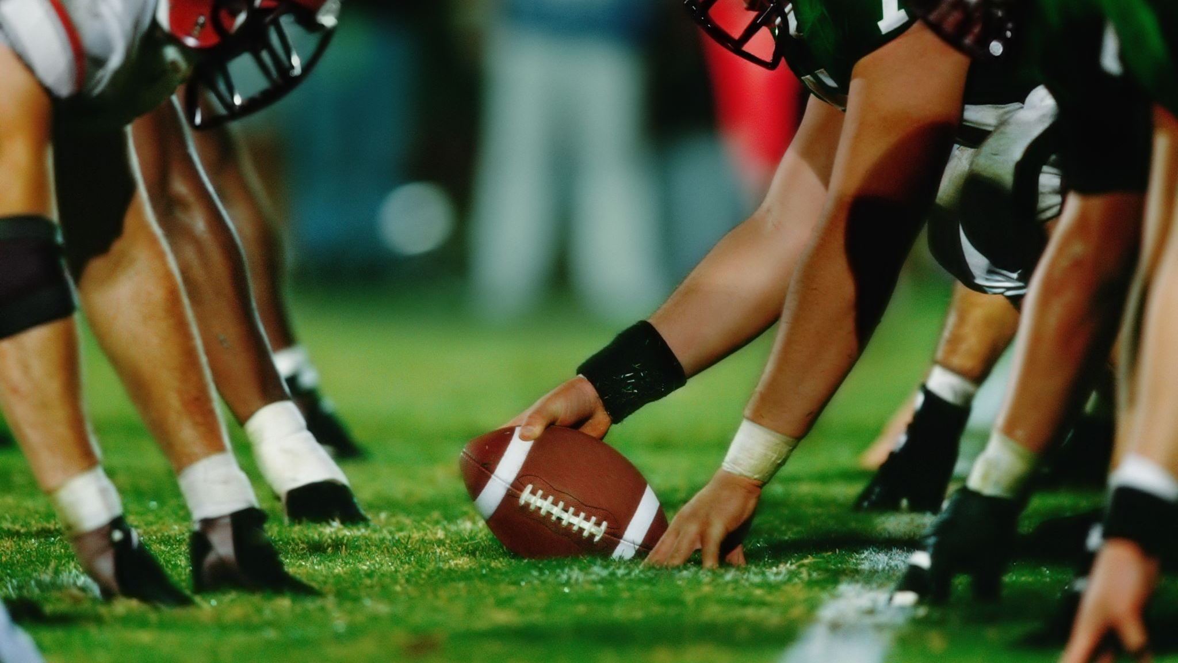
Predicting Play Outcomes in the NFL
Tucker, Taylor
Shoriz, George
Lisman, Zack
Casillas-Colon, Abner
Lotane, Charles

Slide 2



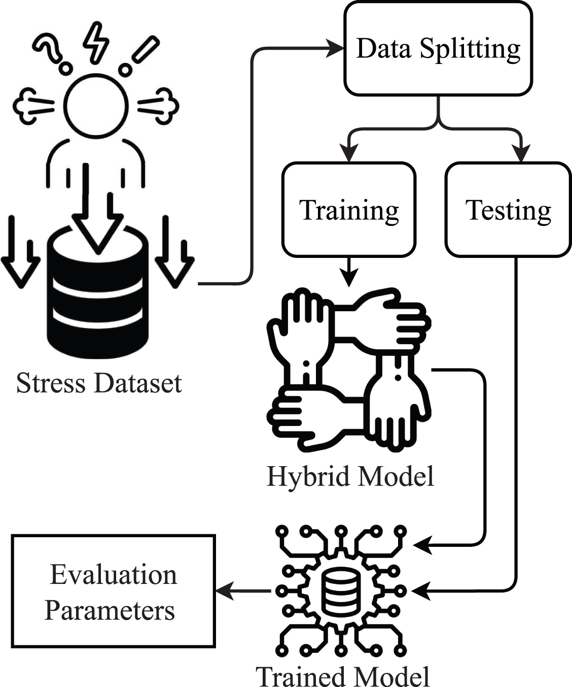
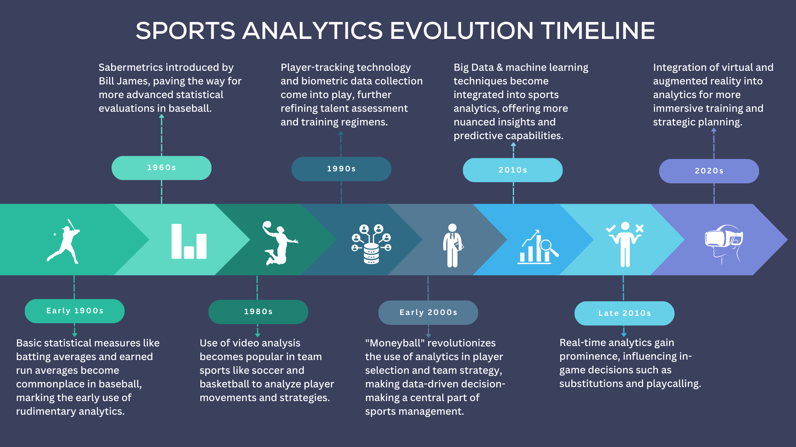
Overview
Objective
Data Source
Methodology
Implications
Conclusion

Slide 3
Motivation
Analyzing predictive plays is a useful applied model that has useful applications in both a narrow and broad scope.
At a core level this is valuable to both coaching staff and fans who want to understand football at a more fundamental level.
In wider context we can explore modeling win likelihood, using play efficiency to improve game scheme, modeling player value, or predicting outcomes for sports betting.

Slide 4
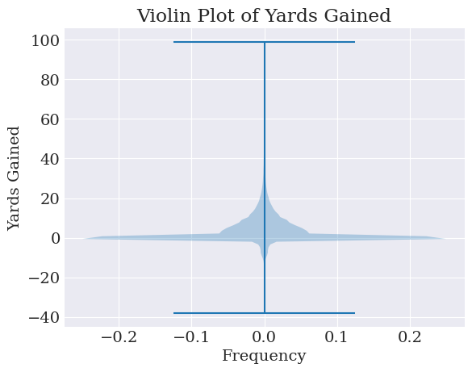
Dataset
Sample of columns:
'quarter_seconds_remaining'
'solo_tackle_2_team'
'away_timeouts_remaining'
'passer_player_name'
'qb_hit_2_player_name'
'punt_downed'
'comp_yac_wpa'
'return_yards'
'sack'
'return_touchdown'
Compiled by Maksim Horowitz, Ron Yurko, and Sam Ventura from Carnegie Mellon
https://www.kaggle.com/datasets/maxhorowitz/nflplaybyplay2009to2016
Dataset Makeup:
255 features
449,371 Observations
Play-level observations from all NFL games from 2009 to 2018
Computational Considerations
700mb CSV file
Encoding for categorical features will increase dimensionality
Expect to use dimensionality reduction techniques, namely PCA
Expect to perform domain knowledge-based feature selection
Notes:
The dataset was compiled by a group of researchers from Carnegie, who subsequently developed nflscrapR, a web scraper for nfl data
The dataset is comprised of 255 features across nearly half a million observations
The dataset is quite expansive and exhausted – personell, formation, situational, and environmental factors

Slide 5
Related Work
Matt Gifford, Tuncay Bayrak, "A predictive analytics model for forecasting outcomes in the National Football League games using decision tree and logistic regression", Decision Analytics Journal, Volume 8, 2023, 100296, ISSN 2772-6622. [TAYLOR]
Lack of deep learning framework
Ensemble methods tend to outperform probabilistic models
Defense-adjusted Value Over Average (DVOA) as a target metric
"Compares the success of a team during a given play with the expected result when factoring the situation, down, distance and the opponent"
Joash Fernandes, Craig et al. "Predicting Plays in the National Football League". 1 Jan. 2020 : 35 – 43. [CHARLIE]
Seeking to maximize prediction accuracy in context is a flawed approach as it doesn't provide actionable recommendations to coaches pre-snap
Simpler decision tree approach optimized for both accuracy and ability to derive actionable insights
Team-specific models lead to better predictive abiltiy, supporting the notion that NFL plays are extremely context dependent
Guo, Xuyi. “Neural Network Models for Predicting NFL Play Outcomes.” Stanford C230, Stanford University, [CHARLIE] https://cs230.stanford.edu/projects_spring_2020/reports/38964602.pdf.
Football is unique among major sport play predictably due to "discrete pre-snap game states"
Most common result was 0 yards gained, which is unsurprising given it only tracked run and pass plays and that is the result of an incomplete pass
Predictive ability seems flawed but this is unsurprising given limited predictors and no accounting for player ability, pre-snap formarion, and other key context in football
Rahman, M.A. "A deep learning framework for football match prediction." SN Appl. Sci. 2, 165 (2020).[ZACK] https://doi.org/10.1007/s42452-019-1821-5
Deals with soccer match predictions and world cup data, but lots of characteristics still applicable to football
Predicted 63% of Fifa world cup matches in 2018 accurately
Classification and prediction can be applied from that to analyze run/pass plays, yards expected, and other intended experiments

Slide 6
Intended Experiments
Sequence Model
Predicting Play Distance
Pass/Run Classification
Primary experiment
Predicting next-play attributes using sequence-to-sequence model
Output data might include
Run/pass
Yards gained
Run/pass side
Intended receiver
Encoder-decoder framework
Regression model to predict play distance based on the following features:
Situational
Offensive
Defensive
Aid in feature selection
Classifying next-play type
Using the following features
Situational
Offensive
Defensive
Theoretically split the potential play set in half
Aid in feature selection
How important are situational factors to the play classification?

